Slide 1
ACADEMIC PROJECT PRESENTATION
CS-301 | Python Project
STUDENT NAME(S)
ROLL NUMBER(S)
DEPARTMENT
SUBJECT & CODE
Avijan Maity
BWU/MCA / 26/020
Computer Science
Python MCA17400(P)
Library Management System
A Simple Python Project to Add, Issue, Return Books and Calculate Fines Easily

Slide 2

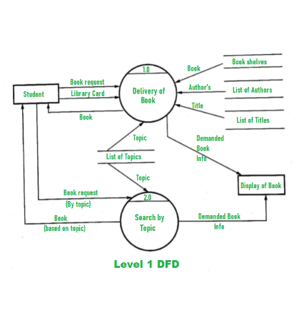
01. INTRODUCTION
What is This Project About?
Easy Library Work
Helps librarians quickly manage books, students, and book issues without paperwork.
Saves Data Automatically
Saves all book and student details into files so data is never lost when program closes.
Automatic Fine System
Calculates late fees automatically if a student returns a book past the due date.

Slide 3
03. OBJECTIVES
Main Goals of This Project
1
Use Python OOP Classes
Catch Invalid Inputs
2
Build standard `Book`, `Student`, and `Library` classes.
Show clear error messages for wrong book IDs or out-of-stock books.
3
Permanent File Storage
Simple Reports & Stats
4
Save and load all data using standard text/JSON files.
Display total available books and most borrowed titles.

Slide 4
04. SCOPE OF PROJECT
What It Can & Cannot Do
Included Features
Limitations
Console UI: Simple menu system for librarians.
No Online Access: Runs only on local computer terminal.
Fast Operations: Add, search, issue, return books.
No Online Payments: Fine is calculated, not paid online.
Fine Calculation: Simple daily fine logic.
No External SQL: Uses simple local files instead of SQL.
No Installation Needed: Runs directly with Python.

Slide 5
05. LITERATURE REVIEW
Old Registers vs Proposed Project
Feature | Old Paper Register | Our Python Project
Data Safety | Registers get damaged easily | Saved permanently in files
Search Speed | Slow manual reading | Instant search by title or author
Fine Calculation | Manual counting mistakes | 100% accurate automatic fines
Statistics | Very hard to calculate | Instant total & top books report

Slide 6



06. PROPOSED SYSTEM
Key System Features
Book Operations
Student Records
Issue & Return
Add new books, update available copies, and list all books clearly.
Track student IDs, names, and list of books currently issued to them.
Issue books safely and calculate fines automatically when returning.

Slide 7




07. METHODOLOGY
Tools & Technologies Used
Python 3
OOP Concept
File Handling
CLI Menu
Main Programming Language
Clean Classes & Objects
TXT / JSON for Records
Easy Terminal Interface

Slide 8
08. SYSTEM STRUCTURE
Main Python Classes
class Book
class Student
class Library
• book_id
• student_id
• books dictionary
• title
• name
• students dictionary
• author
• issued_books list
• save_to_file()
• available_copies
• issue_book()
• load_from_file()
• total_issued
• return_book()
• calculate_fine()

Slide 9
10. TESTING & RESULTS
Project Test Cases
Test Name | What We Tested | Result | Status
Issue Out of Stock | Tried issuing book with 0 copies left | Showed "Not Available" message | PASSED
Fine Calculation | Returned book after 18 days | Charged 4 days fine correctly | PASSED
Wrong Book ID | Entered invalid ID like 9999 | Handled safely without crash | PASSED
File Persistence | Restarted Python application | All added books reloaded safely | PASSED

Slide 10



11. CONCLUSION
Project Summary
All Goals Met
No Crashes
Data Saved
Successfully created a working Python app for all library operations.
Handled wrong inputs using try-except blocks safely.
Files store data permanently so records are never lost.

Slide 11



12. FUTURE SCOPE
Future Improvements
Graphical UI
Database Storage
Barcode Scanner
Add buttons and windows using Tkinter or PyQt.
Connect SQLite database instead of text files.
Scan books directly for ultra-fast checkouts.

Slide 12
THANK YOU

